Slide 1
Cyber Security
Action against cyber crime

Slide 2
What is cyber security?
Cyber security standards are security standards which enable organizations to practice safe security techniques to minimize the number of successful cyber security attacks.
Cyber security refers to the technologies and processes designed to protect computers, networks and data from unauthorized access, vulnerabilities and attacks delivered via the internet by cyber criminals.
Though, cyber security is important for network, data and application security.

Slide 3
What is cyber crime?
The former description were “computer crime”, “computer-related crime” or “crime by computer”. With the pervasion of digital technology, some new terms like “high-technology” or “information-age” crime were added to the definition. Also, internet brought other new terms, like “cybercrime” and “net” crime.
Other forms include “digital”, “electronic”, “virtual”, “IT”, “high-tech” and “technology-enabled crime”.

Slide 4
Why should we care?
It is a criminal activity committed on the internet.
Cyber crime- where computer is a either a tool or target or both.

Slide 5

Challenges For Cybersecurity
Virus
Hackers
Malware
Password Cracking

Slide 6

Viruses
A virus is a “program that is loaded onto your computer without your knowledge and runs against your wishes”.

Slide 7
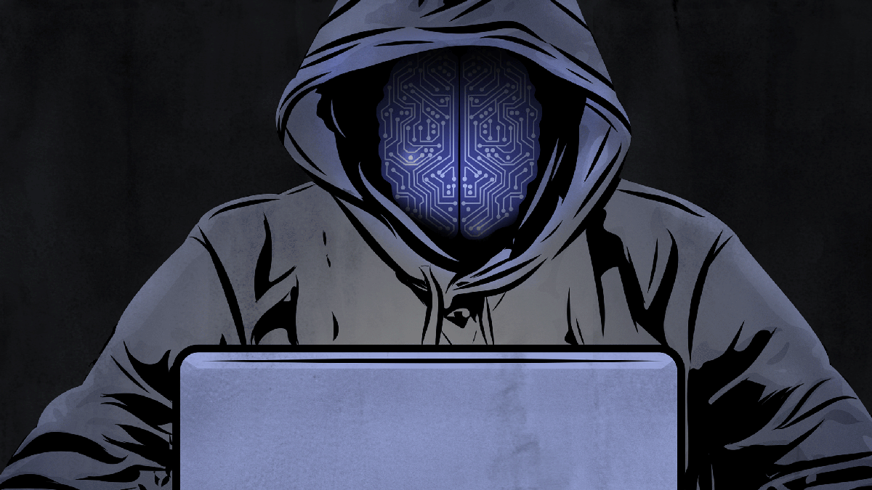
Hackers
In common a hacker is a person who breaks into computer, usually by gaining access to administrative controls.

Slide 8
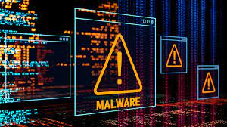
Malware
The word “malware” comes from the term “MALicious softWARE” .
Malware is any software that infects and damages a computer system without the owner’s knowledge or permission.

Slide 9

Password Cracking
Password attacks are attacks by hackers that are able to determine passwords or find passwords to different protected electronic areas and social network sites.

Slide 10
How can we protect?
Read Privacy policy carefully when you submit the data through internet.
Encryption : lots of website uses SSL (secure socket layer) to encrypt a data.
Disable remote connectivity.
By using effective security controls including strong passwords and the use of firewalls can help.

Slide 11
Safety tips….
Use antivirus software.
Insert firewalls, pop up blocker.
Uninstall unnecessary software.
Maintain backup.
Check security settings.
Use secure connections.
Use strong passwords, don’t give personal information unless required.

Slide 12
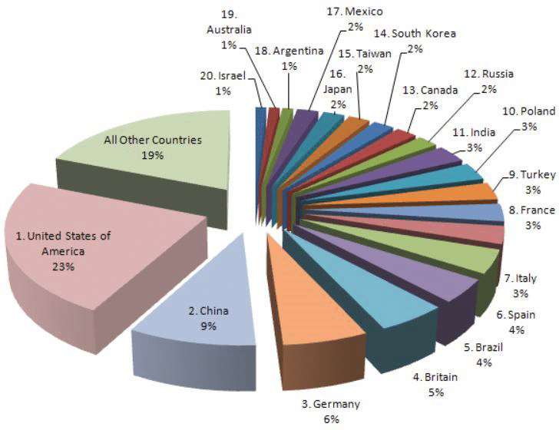
INDIA STANDS 11th IN THE CYBER CRIME IN THE WORLD

Slide 13
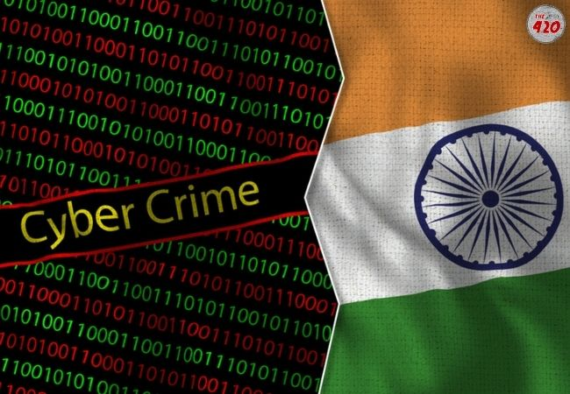
Cyber Security Strategy – India
Security Policy, Legal Framework
IT Act, 2000
IT (Amendment) Bill, 2006 – Data Protection & Computer crimes
Research and Development
Cyber monitoring
Network Security

Slide 14
Conclusion
Only way to be safe is pay attention and act smart.

Slide 15
THANK YOU
BY :- VIVEK RAUTELA

